Slide 1
Information for Lecturers
Dear Lecturer,
Thank you for including the information on the following slides in your first class. By doing so, you are making an important contribution to fostering an open, equitable and learning-friendly environment at our University, as well as to strengthening respectful interactions.
The slides are intended to support the shaping of the course together with students and to provide guidance in addressing potential barriers or incidents.
Many thanks and best regards,
Your Executive Support Unit for Diversity and Gender Equality, on behalf of the Vice President for International Affairs and Diversity,
Professor Christina Hansen

Slide 2

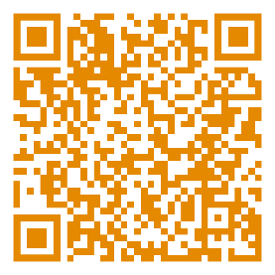
Lecture or presentation title
Questions or Concerns?
Overview of support services at the University of Passau
Presenter’s name or other information
Date

Slide 3
Welcome!
We all share responsibility for the success of this course.
This course is intended to be a place where:
    you have room to pursue your own intellectual path and actively help shape academic discussion.
    discrimination and exclusion are not tolerated.
    every contribution is valued, and responsibility is shared collectively.
The necessary conditions for this are:
    Respect – for diverse perspectives.
    Openness – to dialogue and a willingness to learn.
    Solidarity – through mutual consideration, we create a safe and equitable space for everyone.
  If you have any questions or concerns, please feel free to contact me at any time: Contact

Slide 4
Guidelines for equal opportunities in our course
If you encounter barriers at the University that affect your ability to participate fully in your studies (e.g. health-related issues or caregiving responsibilities), please feel free to contact me or the relevant support services. Such circumstances can be taken into account when designing course materials and lessons.
Under certain conditions, you may apply for academic adjustments/exam access arrangements. To do so, please contact the Student Disabilities Officer.
If you experience or witness discrimination during the course – whether involving other participants or myself – please feel free to speak to me directly. Alternatively, you may contact one of the other designated support or reporting services available at the University.
Please let me know the name and pronouns you would like me to use when addressing you.
Questions or Concerns?
Overview of support services at the University of Passau

